Slide 1
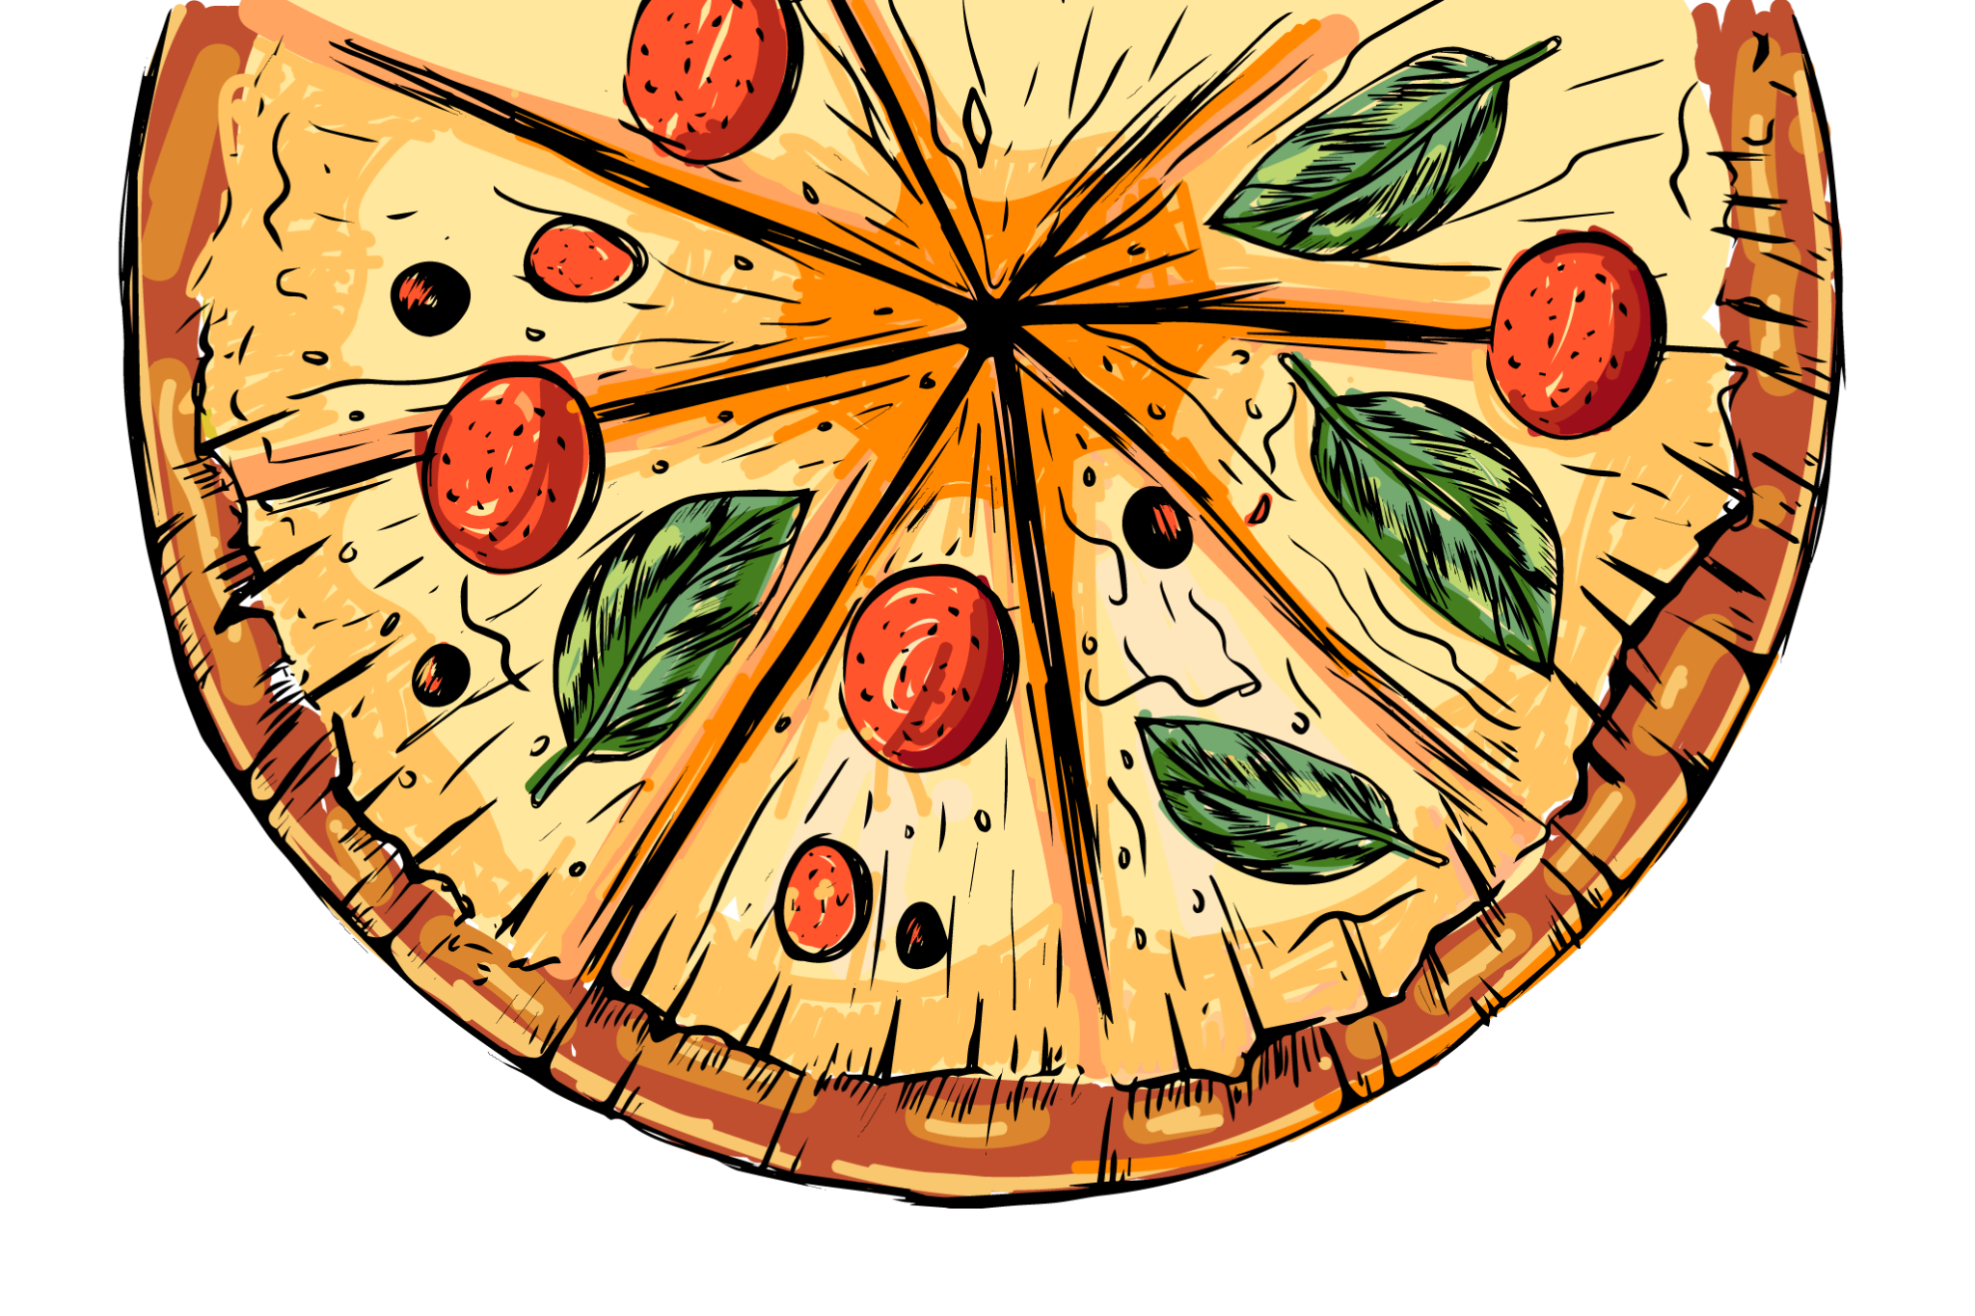



PIZZA HUT ANALYSIS
www.slidesgo.es
BY ADARI UMA SAI SANKAR

Slide 2
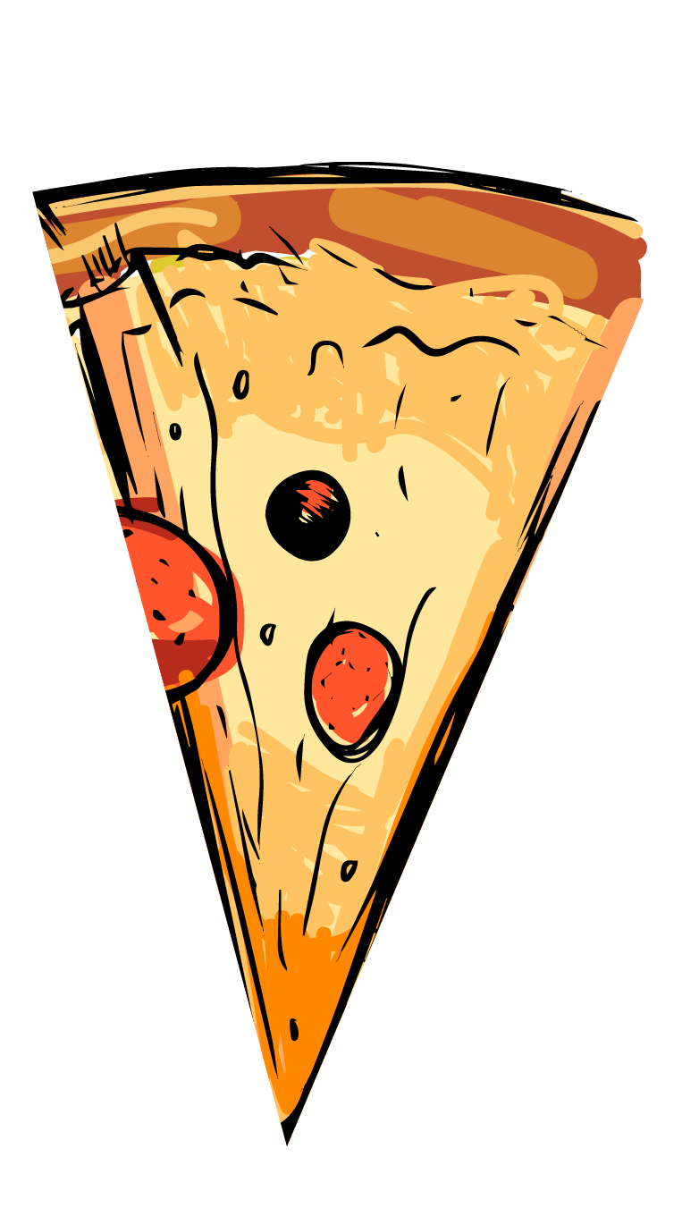


INTRODUCTION
Pizza Hut is a leading global fast-food chain generating large volumes of sales data daily from online and offline orders.
The data includes details such as pizza types, sizes, prices, order timings, quantities, and categories.
Although the data is vast and detailed, it does not directly provide useful business insights.
Structured analysis is required to convert raw data into meaningful information.
This project uses SQL to analyze sales data, identify customer preferences, understand order patterns, and evaluate revenue contributions.
The insights help in decision-making, improving marketing strategies, and enhancing operational efficiency for business growth.

Slide 3
PROBLEM STATMENT
Pizza Hut lacks detailed insights into customer ordering behaviour from existing sales data.
Peak ordering times and customer demand patterns are unclear.
The most popular pizza types and sizes need to be clearly identified.
High revenue-generating products are not well-highlighted.
Inefficient inventory planning due to limited data analysis.
Promotional strategies are not tailored based on sales trends.
SQL-based analysis is needed to convert raw data into actionable insights.

Slide 4

DATA DESCRIPTION
04
03
02
Order_deatils.csv
01
Orders.csv
Order_id
Pizza_id
Quantity
Order_details_id
Date
Time
Order_id
Order_details_id
Pizza_types.csv
Pizza.csv
Name
Category
Ingredients
Pizza_type_id
Size
Price
Pizza_id
Pizza_type_id

Slide 5
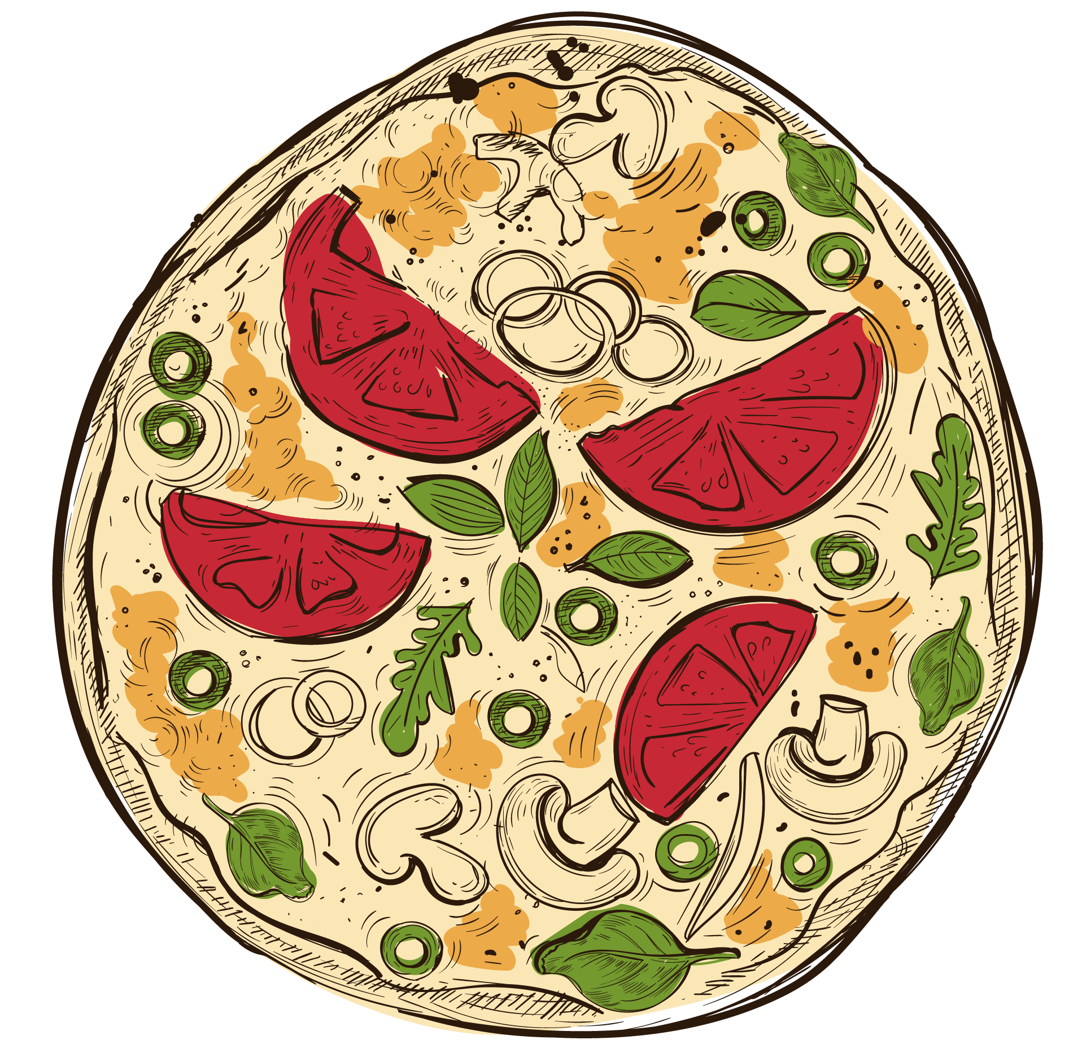
Basic Analysis
Total Orders Count Revenue Calculation Most Expensive Pizza Most Ordered Pizza Size Top 5 Popular Pizzas

Slide 6
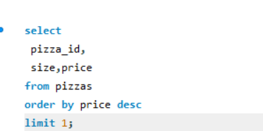
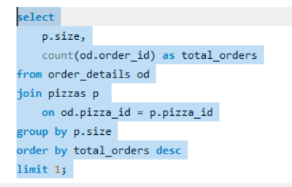
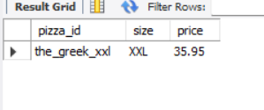
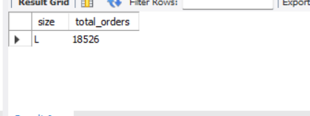
Total Orders Count
Most Ordered Pizza Size
Most expensive pizza :the_Greek_xxl
The Most orderd pizza : Size L
total_orders :18526

Slide 7
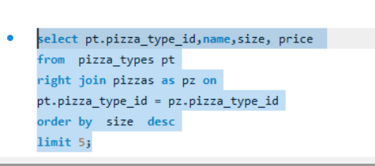
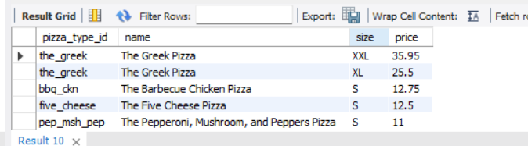
TOP 5 POPULAR PIZZAS

Slide 8
INSIGHT
Total Orders: 21,350
Total Revenue: ₹817,860
Revenue Most Expensive Pizza: The Greek Pizza (XXL size, ₹35.95)
Most Ordered Size: Large – 18,526 orders, indicating strong customer preference for
value-sized pizzas.
Top 5 Most Ordered Pizzas: Classic, Barbeque Chicken, Hawaiian, Pepperoni, Thai Chicken
→ Combined quantity: 12,096 units.
Trend: Steady growth over time (based on cumulative revenue analysis)

Slide 9
Intermediate Analysis
Pizza Quantity by Category
Pizza Quantity by Category
Pizza Distribution by Category Average Daily Pizza Orders
Top Pizza Types by Revenue
Pizza Quantity by Category Order Trends by Hourz

Slide 10
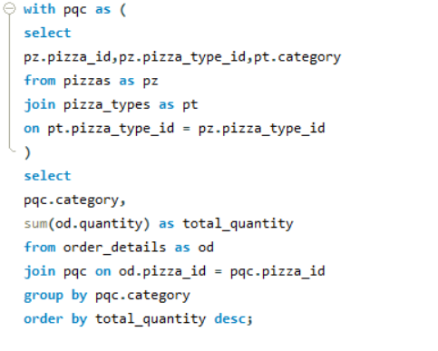
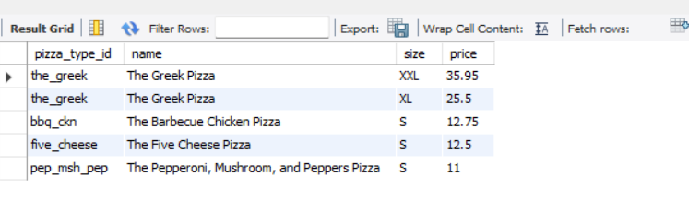
Pizza Quantity by Category

Slide 11
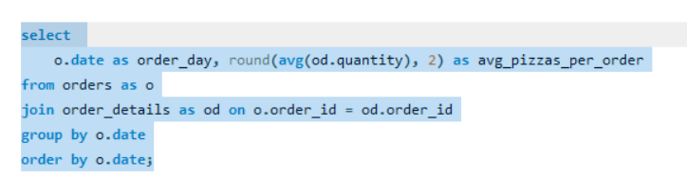
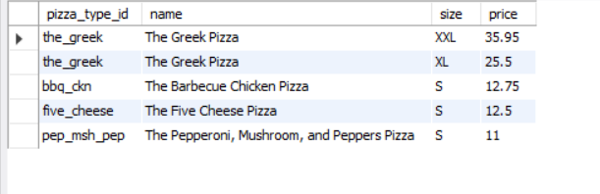
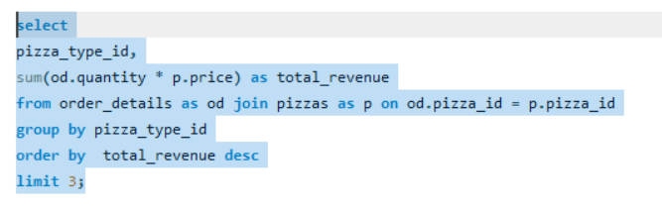
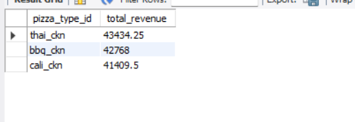
Average Daily Pizza Orders
Top Pizza Types by Revenue

Slide 12
INSIGHT
Categories Available: Classic, Veggie, Supreme, Chicken
Peak Ordering Time: 12 noon – 1 PM (lunch hour spike)
Average Daily Orders: 138 pizzas
Revenue Drivers: Top 3 pizzas by revenue — Thai Chicken, Barbeque Chicken, and California Chicken — generated ₹127,611.75 combined.

Slide 13
Advanced Analysis
Revenue Contribution by Pizza Type
Cumulative Revenue Over Time
Top 3 Pizza Types by Revenue in Each Category

Slide 14
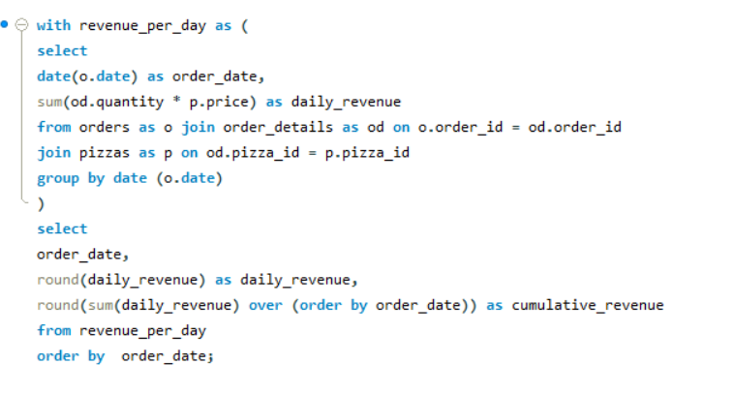
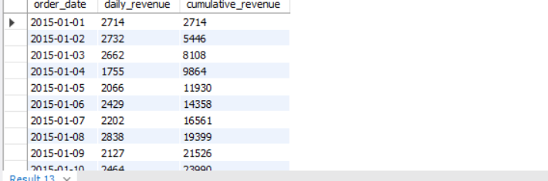
Cumulative Revenue Over Time

Slide 15
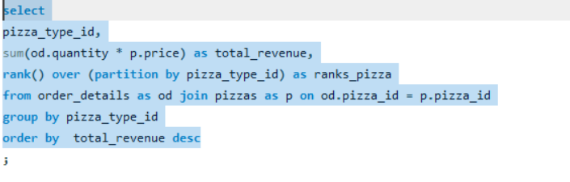
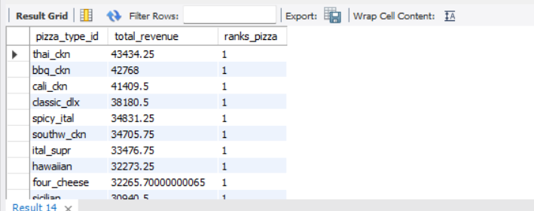
Top 3 Pizza Types by Revenue in Each Category

Slide 16
INSIGHTS
The Highest Revenue Percentage is 26.91% (Classic) and the Minimum Revenue Percentage is 23.68% (Veggie)
The Revenue Generated by top 3 Chicken pizzas is 1,27,611.75
The Revenue Generated by top 3 Classic pizzas is 1,00,615.25
The Revenue Generated by top 3 Supreme pizzas is 99,248.5

Slide 17
RECOMMENDATION
Menu Strategy – Highlight the best-selling pizzas in-store and online, and re-evaluate low-performing varieties.
Promotional Offers – Introduce evening meal deals and weekend family combos to capitalize on peak demand.
Size Upselling – Encourage upgrades from Medium to Large pizzas through discounts or combo pricing.
Category Growth – Innovate in veggie and supreme pizzas by launching new flavors or bundling them with popular pizzas.
Operational Efficiency – Strengthen staffing and delivery resources during peak evening hours to ensure faster service.
Customer Engagement – Introduce a simple loyalty program that rewards frequent buyers with free sides or drinks after a certain number of orders, to increase repeat purchases.

Slide 18
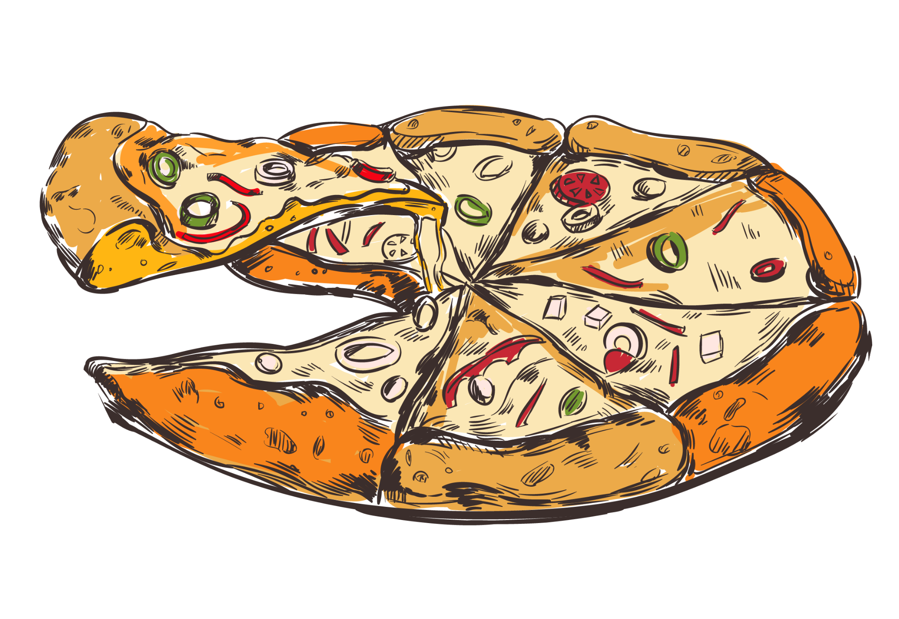

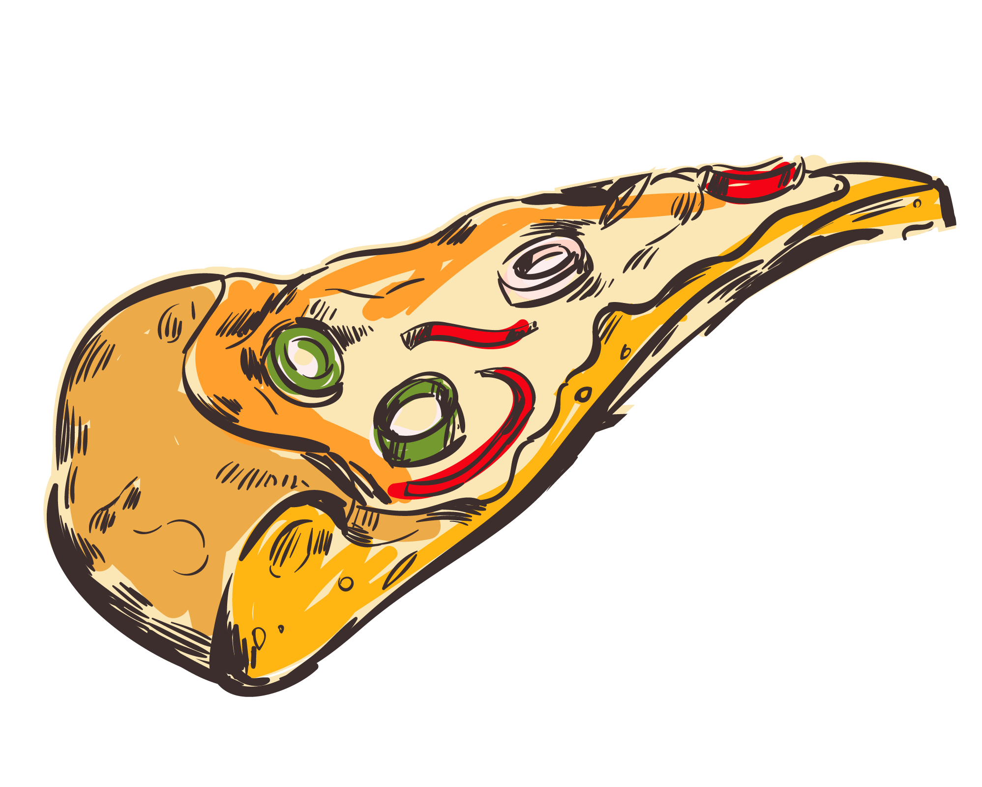
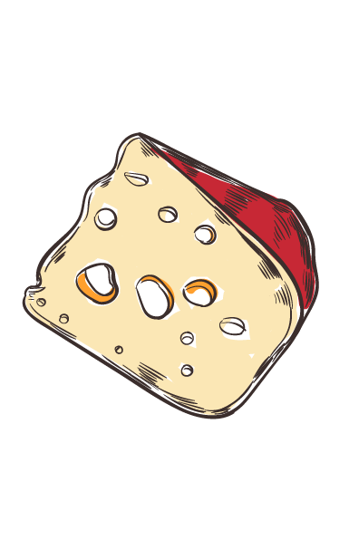
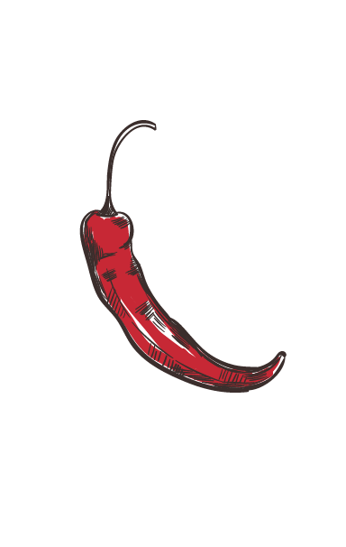


THANK YOU!

